Slide 1
SAP Versions Release and History of Evolution
IBPSES
CT104-3-2-VD1

Slide 2
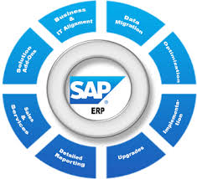

SAP
SAP is one of the leading ERP’s (i.e. Enterprise Resource Planning) software in the world and SAP has a very interesting evolution from the basic product to the product used till date.
SAP: “System, Applications and Products in Data Processing Services”

Slide 3

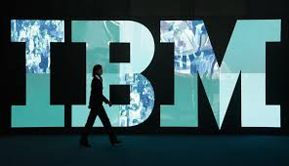
The early years
Building on the dream of “real-time” computing: Software that processes data when customers ask it to rather than overnight in batches.
SAP was started as a private partnership under German system in 1972.
SAP is a proprietary product of German Company SAP AG. SAP was found by five ex IBM employees who had been working in IBM enterprise wide software division.
The name of the employees who found the company was as follows:
Dietmar Hopp.
KlausTschira.
Hans-Werner Hector.
Hasso Plattner.
Claus Wellenreuther.

Slide 4
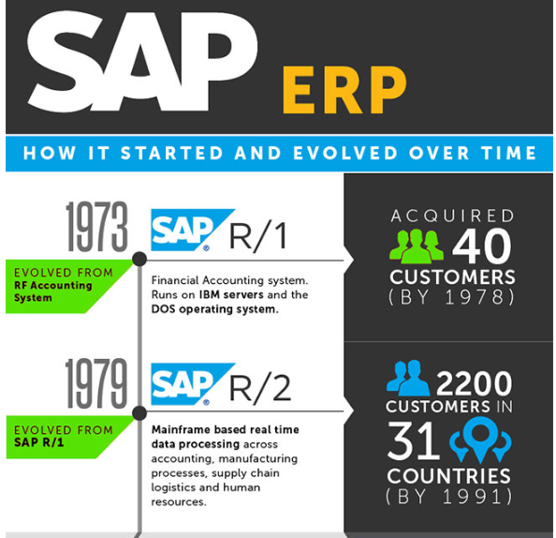
SAP completes its first financial accounting system – RF and eventually bear the name SAP R/1.
Module:
Payroll + Accounting system
Technology:
IBM Server
DOS operating system

Slide 5
The SAP R/2 era
Real-time touches more of the business: SAP R/2 packaged mainframe software application processes in real time and integrates all of an enterprise’s business functions.
Module:
Payroll + Accounting system
Material Management
Manufacturing
Sales + Distribution
Technology:
Mainframe
Notes:
SAP introduces its new, more user-friendly interface for SAP R/2
The company also kicks off various development projects –
in production and other areas – with new tools, such as the ABAP/4 programming environment.

Slide 6

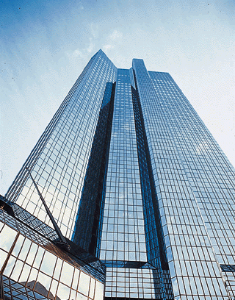

SAP System
System
The applications use ABAP/4 language for building enterprise software
(Advanced Business Application Programming)
SD
Sales &
Distribution
FI
Financial
Accounting
MM
Materials
Mgmt.
CO
Controlling
PP
Production
Planning
R/3
AM
Fixed Assets
Mgmt.
QM
Quality
Manage-ment
Client / Server
ABAP/4
TR
Treasury
PM
Plant Main-tenance
WF
Workflow
HR
Human
Resources
IS
Industry
Solutions

Slide 7
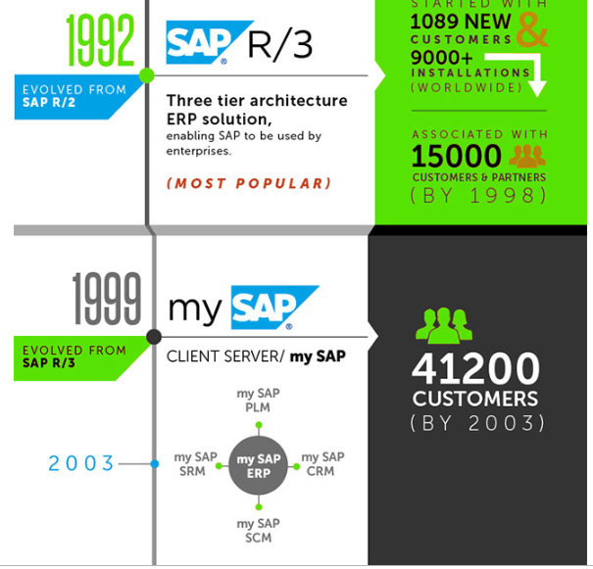
The SAP R/3 era
Real-time reaches the desktop: A client-server version of the standard application software allows businesses to run more efficiently around the world
.
SAP brings SAP R/3 to the general public
Module:
Payroll + Accounting system
Material Management
Manufacturing
Sales + Distribution
other
Technology:
The evolution of new technology C-S.

Slide 8
Architecture
Architecture of an ES refers to:
- Technical structure of the software
The ways users interact with the software.
Most of the modern Enterprise Systems have either
Client Server Architecture: 3 – Tier Architecture
Distributed Computing
Service Oriented Architecture
Notes:
Ar

Slide 9
Client/Server Environment
Client- Server is a network architecture in which each computer or process on the network
Basic Definition:
Server: provides services
Client: requests for services
Service: any resource
(e.g., data,, file, object, application and etc.)
Notes:
With in the context of Client/Server software,
all software is characterized as either client (software that requests a service) or server (software that can provide a service).
Client-workstation which user run the application
Server-powerful computer provide service to client

Slide 10
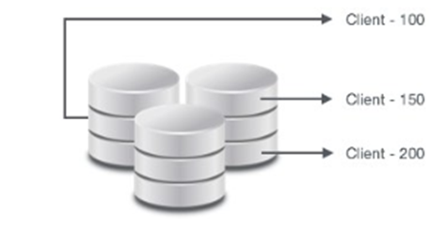
Client/Server Environment
Client
Software/hardware combination that can make a request for services from a central repository of resources.
A client is a logical portion of an SAP R/3 physical database. From a business standpoint, a client can be interpreted as a logical group of companies

Slide 11
Client/Server Environment
Server
Software/hardware combination that can provide services to a group of clients in a controlled environment

Slide 12
SAP R/3 Architecture
SAP R/3 is one of the main product of SAP,where:
R stands for RealTime
number 3 relates to three tier application architecture:
a) Presentation layer
b) Application layer
c) Data layer
Most of the business in todays world runs on SAP R/3 system. About 80% of the companies implemented this software.

Slide 13
Three-Tier Client/server R/3 Architecture
Three components:
Presentation: GUI—Graphical User Interface or Web Interface
Application
Database server (one single location)
Notes:
Users can access SAP system in two ways:-Through SAP GUI, Through Web browser
It's called front-end. Only the front-end is installed in the user's PC not the application/database servers.
Front-end takes the user's requests to database server and application servers.
Application Servers:- Application server is built to process business-logic.
Database server stores and retrieves data as per SQL queries generated by ABAP and java applications.

Slide 14
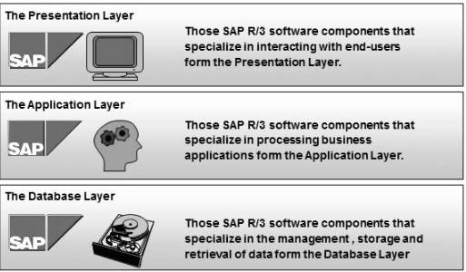
Notes:
Much of work u do on the internet uses a 3 tier architecture.
Your browser is the presentation layer
Through your browser, u ca connects to many system (websites) that provide a variety of capabilities such as email, purchasing goods, sharing information
These website contain applications that execute the request u send through the browser (via http)
They retrieve and store data in a connected database.

Slide 15

Presentation Layer
Presentation Layer is also known as client Layer
Presentation Layer is a user interaction- enables the user to interact with the relevant application.
This interface is typically called GUI (Graphical user interface)
Example − Desktop, Mobile Devices, laptops
Notes:
The 2 computers do not pass entire screen bak n forth but they exchange
Logical information about control elemets n user inputs.

Slide 16

Application Layer
This layer is the brain of SAP R/3 products- Where the application programs are executed.
This layer consists of application. Application servers include specialized systems with multiple CPUs and RAMs.
Application Layer is also known as Kernel Layer and Basic Layer.
Application Layer serves as a purpose of a communicator between Presentation and Database Layer.
Application server is where the dispatcher distributes the work load to the different work processes makes the job done.
Notes:
Is built to process buss. Logic-contains specific calculations/command to carry out process.
Contains all the algorithms/codes
The entire business processing is done in the application server through:
Special programs known as proprietary programming language
ABAP- advance business application programming

Slide 17
Data Layer
Consist of central database system containing all of the data in R/3 system. Transporting and managing data between applications and the database.
A database interface, using SAP structured Query Language (SQL) for transferring data between application and database servers.
Database servers contain specialized systems with fast and large hard-drives.
Database layer stores the data
Data store can be Business data, SAP system data, SAP tables, Programs.
Examples − Oracle, Microsoft SQL Server, IBM DB/2, Siebel, Sybase, etc.
Notes:
C++
SAP HANA was designed to be a replacement to Oracle

Slide 18
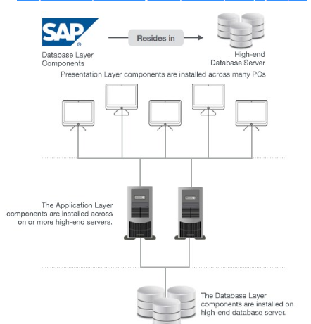

Slide 19
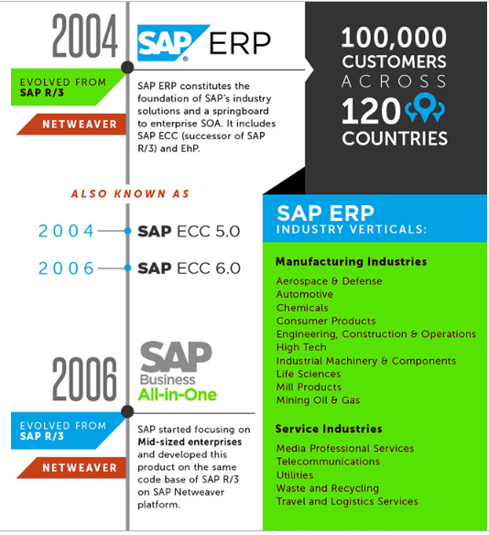
Real-time data where and when you need it
Real-time moves to the Web and beyond: Cloud computing, mobile, and in-memory computing open up new horizons for real-time data access – anywhere.
SAP brings the first version of SAP NetWeaver to market. The response to this new integration and application platform.

Slide 20
Service Oriented Architecture
Architecture pattern in which application component provide service to another components via communication protocol, typically over a network.
Allows system to connect with one another through standardized interfaces called web service.
A service-oriented architecture (SOA) is the underlying structure supporting communications between services.
SOA defines how two computing entities, such as programs, interact in such a way as to enable one entity to perform a unit of work on behalf of another entity.
Service interactions are defined using a description language. Each interaction is self-contained and loosely coupled, so that each interaction is independent of any other interaction

Slide 21
SOA
NetWeaver is SAP's integrated technology platform and is not a product in itself.
Technologies that provide internal connectivity (integration) between SAP modules and external connectivity with other systems,
Eases integration between systems.
Provides framework for development

Slide 22
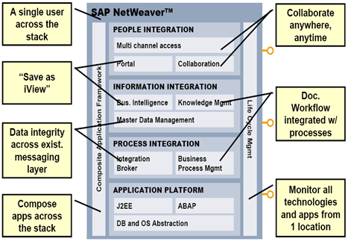

Slide 23
People Integration
People Integration brings functionality and information to people. On the people level, end users will settle for nothing less than a seamless user experience (in spite of the growing system diversity), boundless collaboration functionality, and pervasive access.
Multi-Channel Access - With multi-channel access, you can connect to enterprise systems through voice, mobile, or radio-frequency technology. Multi-channel access is delivered through Mobile Infrastructure.
Portal - This capability provides industry-leading portal technology that delivers unified, personalized, and role-based user access to your heterogeneous IT environment. Portal infrastructure is provided through SAP Enterprise Portal.
Collaboration - Collaboration promotes dynamic communication within permanent and ad hoc teams or communities -- including shared e-mail, calendars, threaded discussions, and document stores.

Slide 24
Information Integration
Information Integration makes both structured and unstructured information available in the enterprise in a consistent and accessible manner. Users demand ubiquitous access to information wherever it resides. That information must be served in a consistent manner and its integrity guaranteed.
Business Intelligence - This capability enables you to integrate, analyze, and disseminate relevant and timely information. It is delivered through SAP Business Intelligence, which provides a robust suite of business intelligence tools to help you create and deploy customized, interactive reports and applications, supporting decisions at every level.
Master Data Management - This capability promotes information integrity across a business network in a heterogeneous IT environment. It enables the sharing of harmonized master data formerly trapped in multiple systems and ensures cross-system data consistency

Slide 25
Process integration & Application Platform
Creating and managing all integration-relevant information. Business Process Management supports the controlling of processes.
Application Platform:
The Application Server provides a complete development infrastructure on which you can develop, distribute, and execute platform-independent, robust, and scalable Web services and business applications. The Application Server supports ABAP, Java, and Web services.

Slide 26
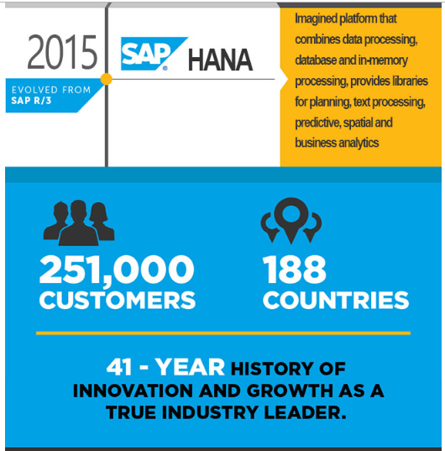
In-memory, cloud computing
SAP unveils the next generation of enterprise software with a new business suite, SAP S/4HANA. Fully built on the SAP HANA advanced in-memory platform

Slide 27
Distributed Computing
A distributed computer system consists of multiple software components that are on multiple computers, but run as a single system.
The computers that are in a distributed system can be physically close together and connected by a local network, or they can be geographically distant and connected by a wide area network.
A distributed system can consist of any number of possible configurations, such as mainframes, personal computers, workstations, minicomputers, and so on. The goal of distributed computing is to make such a network work as a single computer

Slide 28
Grid Computing
Grid computing is focused on the ability to support computation across multiple administrative domains that sets it apart from traditional distributed computing.
Grids offer a way of using the information technology resources optimally inside an organization involving virtualization of computing resources.
Its concept of support for multiple administrative policies and security authentication and authorization mechanisms enables it to be distributed over a local, metropolitan, or wide-area network

Slide 29
Question and Answer Session
Q & A

